Slide 1
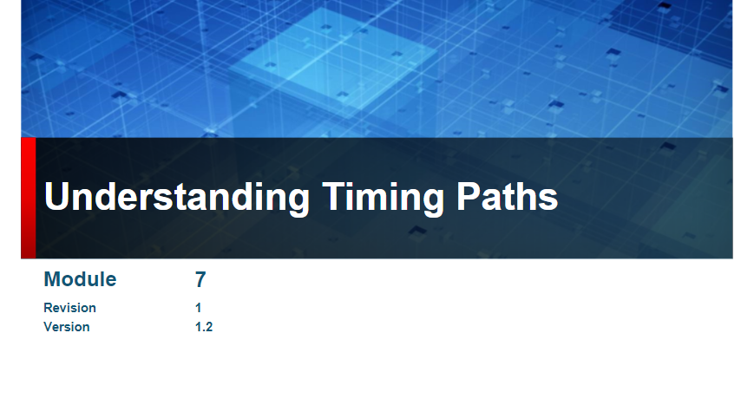

Slide 2
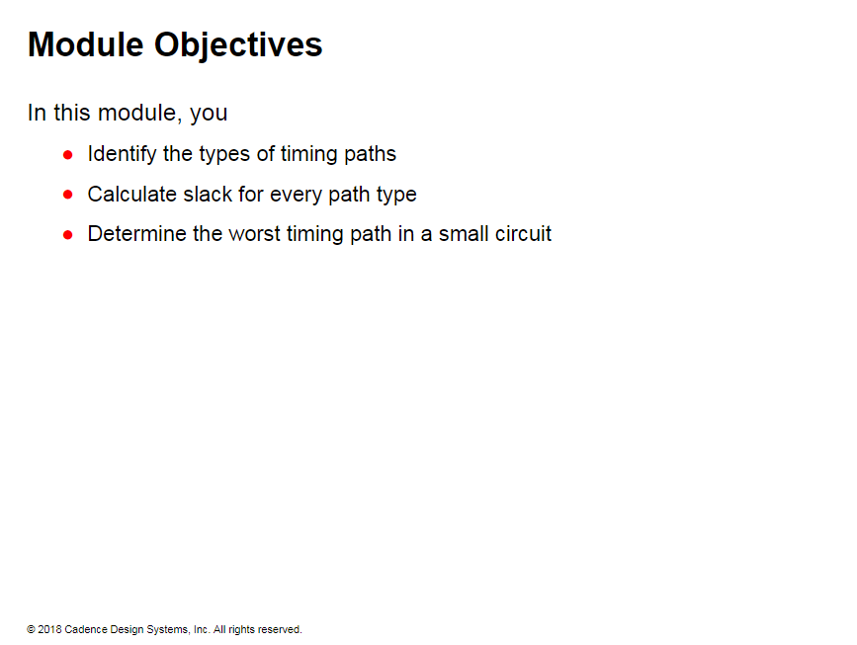

Slide 3
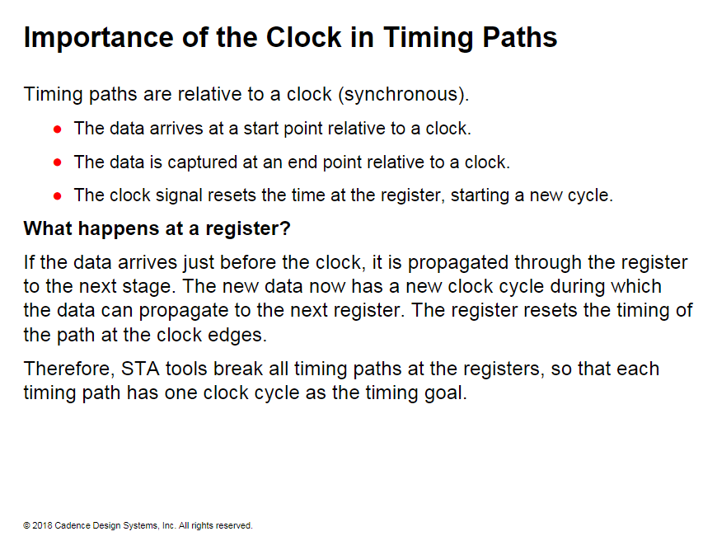

Slide 4
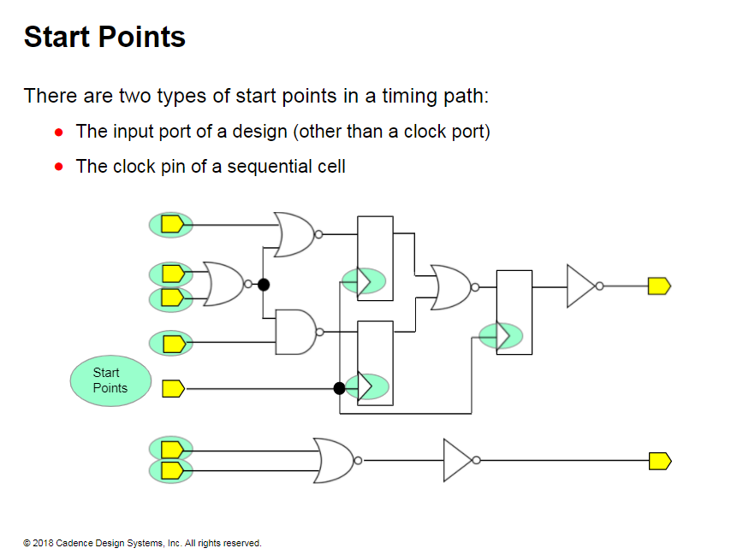
Notes:
A clock port is not considered a start point.
Pin: A pin is an input or an output of a cell or a block in a design. A pin is also known as
a hierarchical port of a design.
Port: A port is an input or an output of a chip or a design.

Slide 5
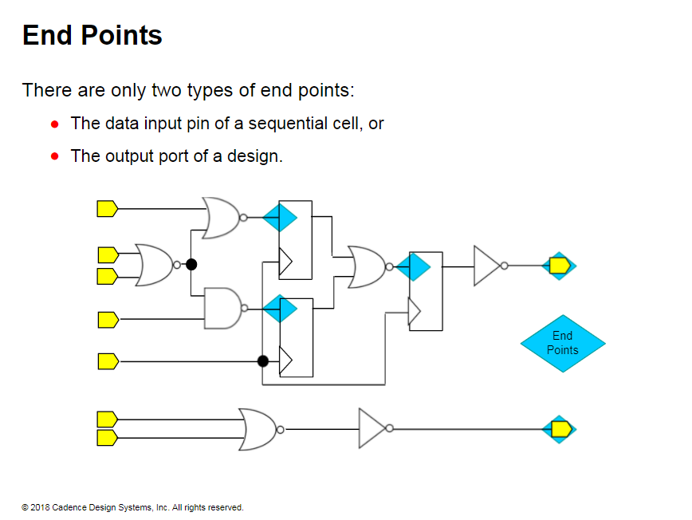

Slide 6
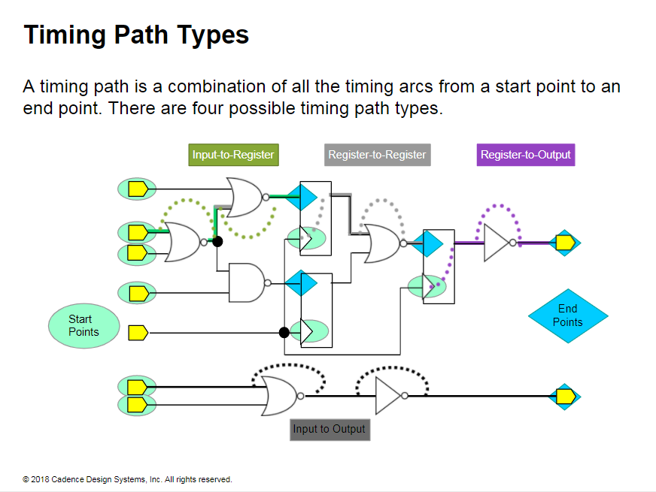
Notes:
For timing analysis, the start-point to end-point combinations are classified into path types. Each of these path types have different requirements and different analysis styles for STA.
The following are the requirements of an STA tool for each path type: 1- Register-to-register paths require the clock definitions.
2- Input-to-register paths require the data arrival time at the port.
3- Register-to-output paths require the external port delay.
4- Input-to-output paths require properly budgeted timing using input and output delays, and if necessary, virtual clocks. Otherwise, you can set path delay restrictions.
There might be multiple paths between the same starting and endpoints. Each path is timed separately by the STA tool to determine the worst path and is used to verify the setup and hold requirements.

Slide 7
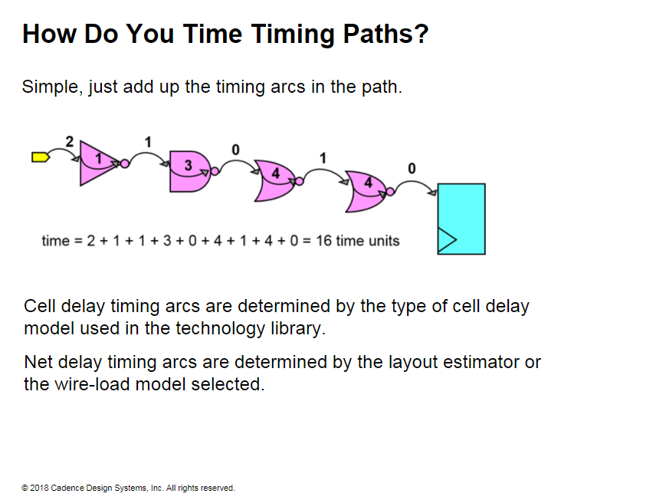
Notes:
How Do You Time Timing Paths?
The STA tool and the synthesis tool take into consideration the effect of unateness on timing arcs.
The libraries contain the information for both rising and falling arcs.
The worst of both the paths between rising/falling input and output rising/falling is also determined.
Therefore, to simplify the discussions in this course. the effect of unateness on the timing paths is ignored.

Slide 8
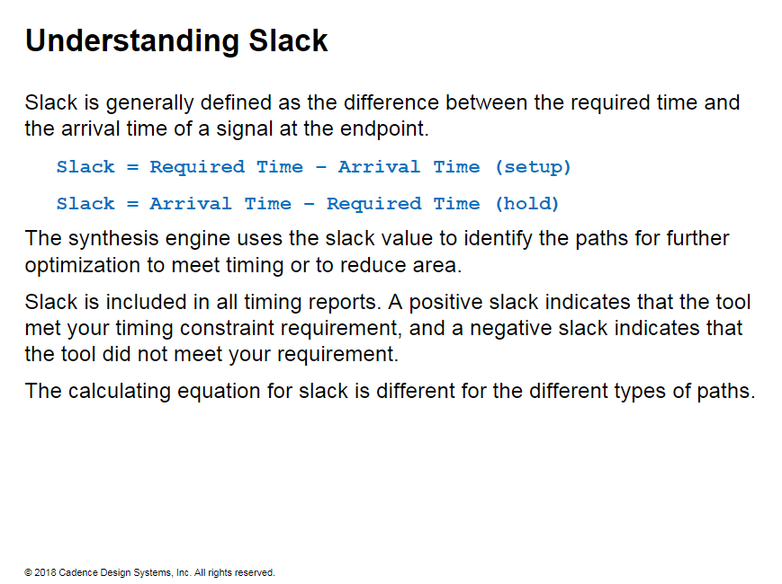

Slide 9
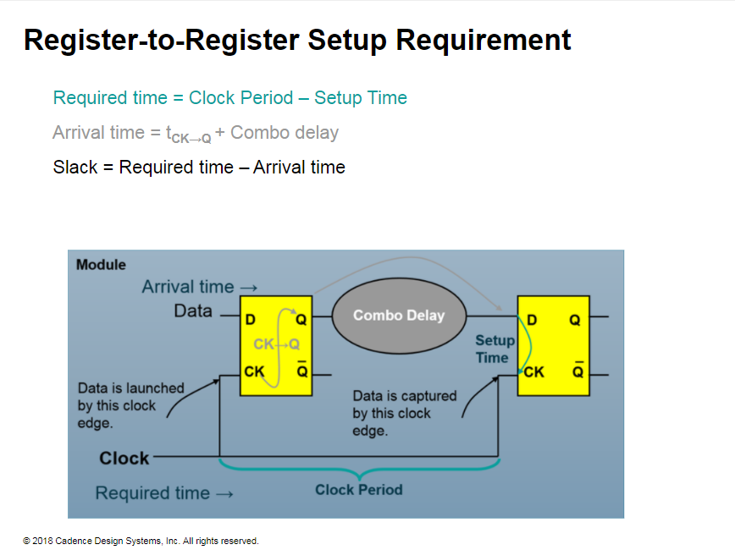
Notes:
Register-to-Register Setup Requirement
The following equation is the setup requirement for the register-to-register path:
clk_to_q+ combo_delay ≤ clock_period - reg setup
Examples and equations throughout this module assume that you are using the same clock with zero insertion delay for the start and end points.

Slide 10
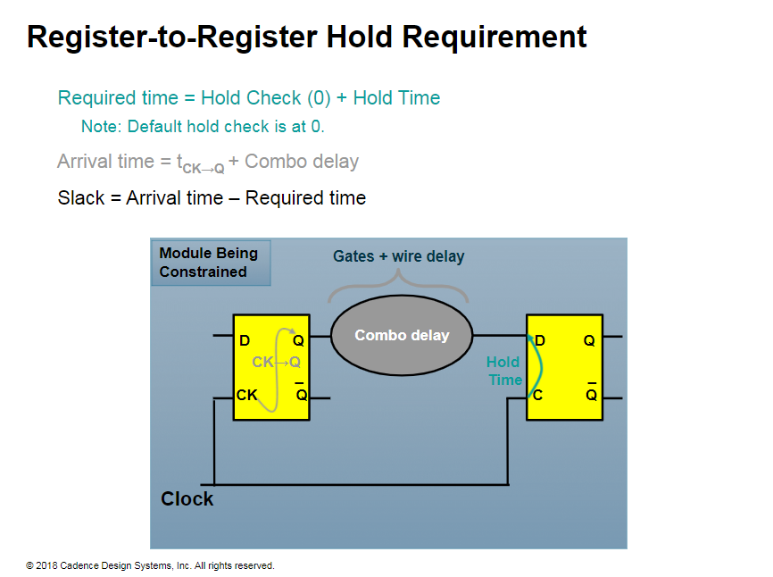
Notes:
Register-to-Register Hold Requirement
The following equation is the hold requirement for the register-to-register path:
clk_to_q+ combo_delay ≥ hold_check(0) + reg setup

Slide 11
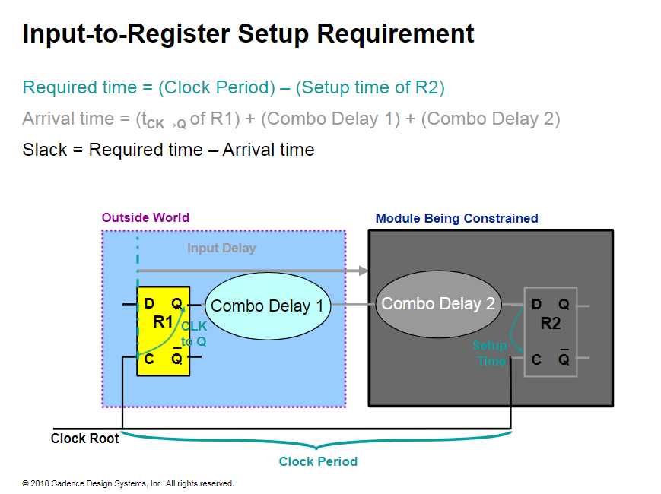
Notes:
Input-to-Register Setup Requirement
The following equation is the setup requirement for the input-to-register path:
Input_delay + combo2 ≤ clock_period - reg_setup
where Input_Delay = clk_to_q + combol
All external delays are measured relative to a clock.

Slide 12
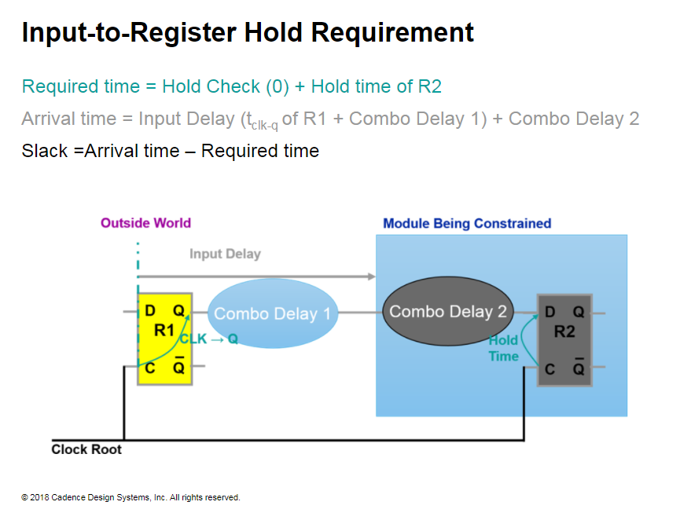
Notes:
Input-to-Register Hold Requirement
The following equation is the hold requirement for the input- to-register path:
Input_delay + combo2 ≥ hold_check(0) - reg_hold
where
Input_Delay = clk_to_q + combol
By default, the hold check is performed at the edge preceding the setup check.
Therefore, in paths where the launch clock and capture clock are the same, the preceding edge would be edge 0 or the launch clock edge.
All external delays are measured relative to a clock.

Slide 13
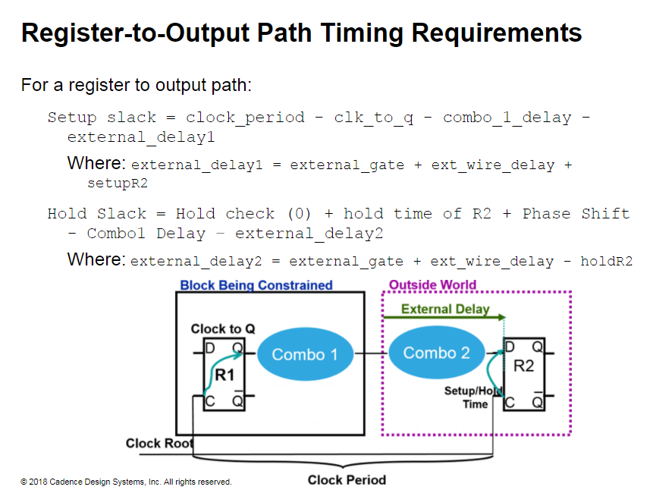
Notes:
Register-to-Output Path Timing Requirements
The following equations are the setup and hold requirements for the register- to-output path:
Setup
Clk_to_q+combol < clock_period - external_delay1
Hold
Clk_to_q+combol > hold_check(0) - external_delay2

Slide 14
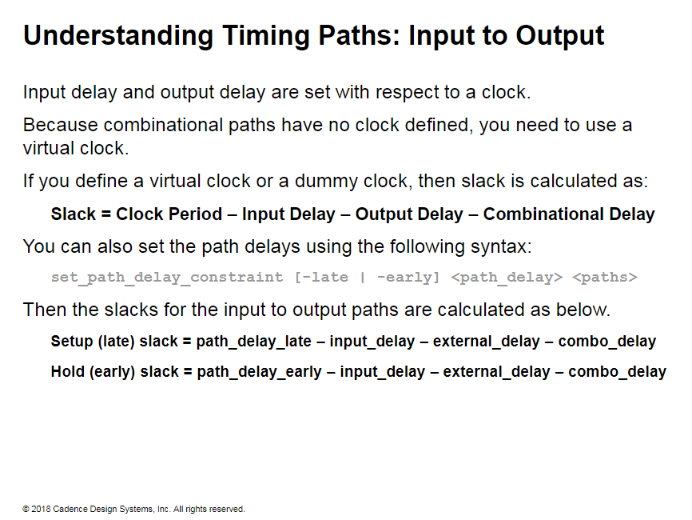
Notes:
Understanding Timing Paths: Input to Output
Virtual clocks are clocks that do not have a port in the design and are primarily created to set input and output constraints on the combinational path.
You can create as many virtual clocks as required. Use the create_clock command and specify a name for each virtual clock. Use these clocks in the design to specify the timing for a combinational logic block.

Slide 15
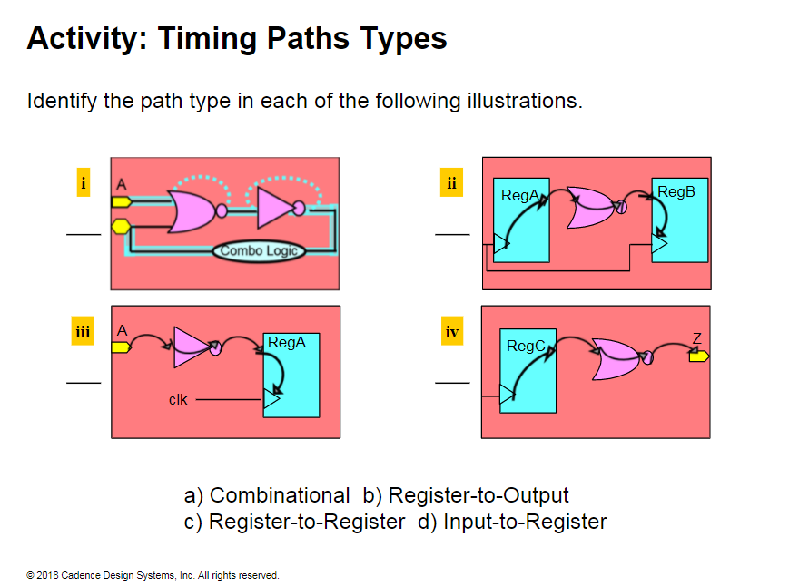

Slide 16
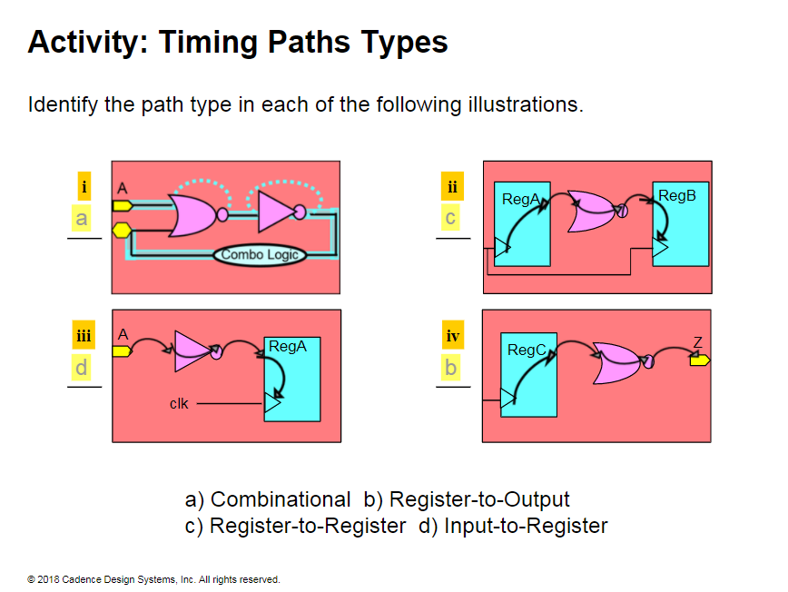

Slide 17
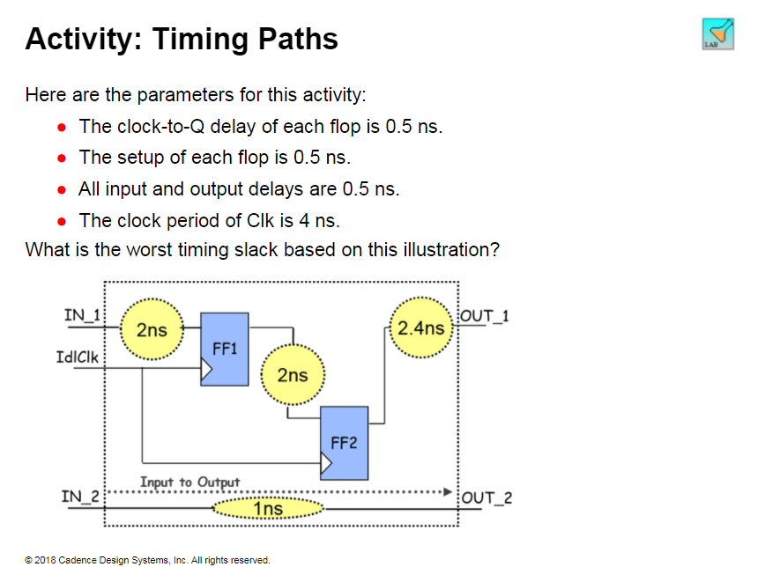

Slide 18
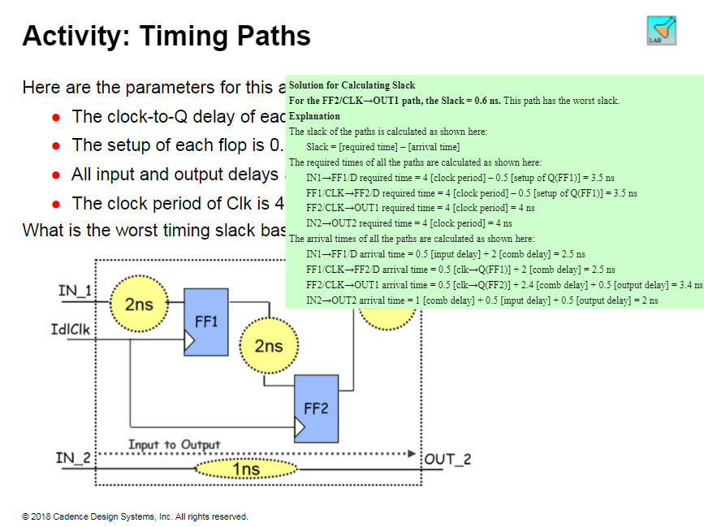

Slide 19
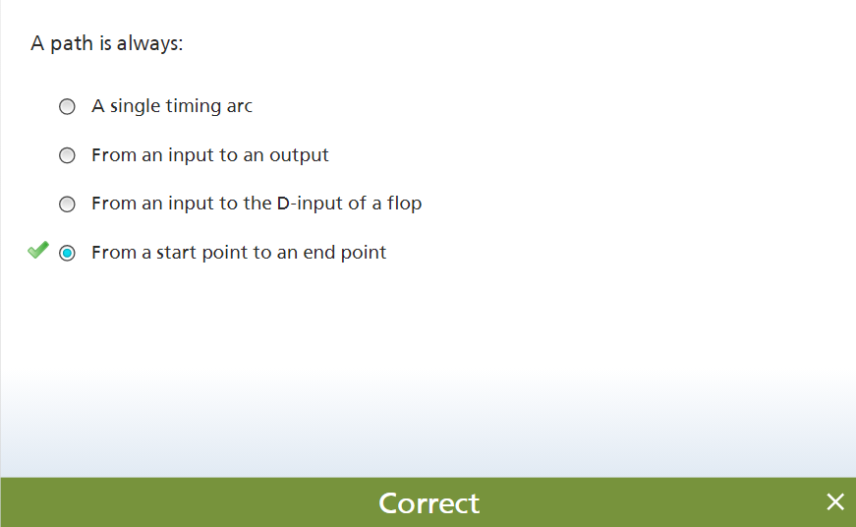

Slide 20
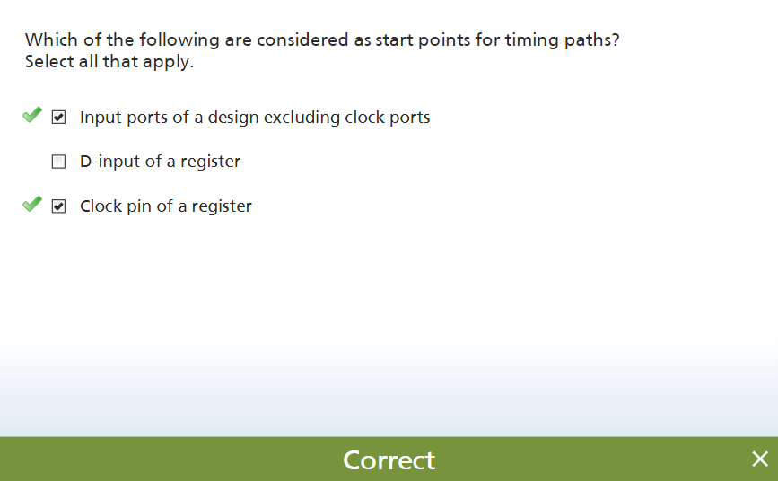

Slide 21
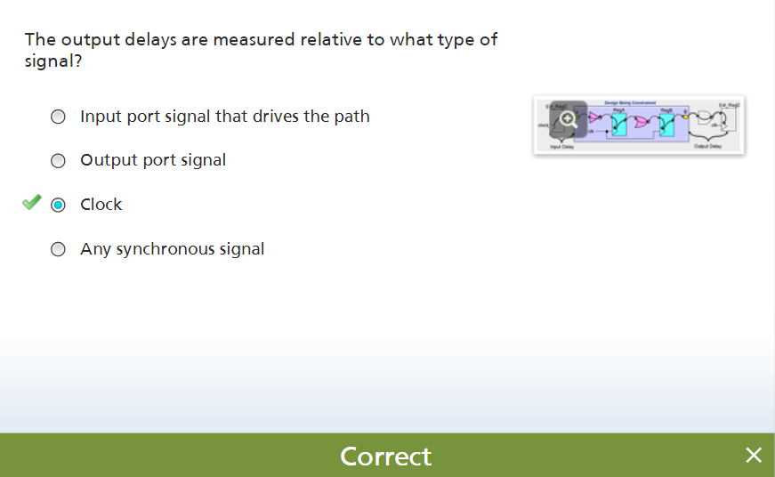
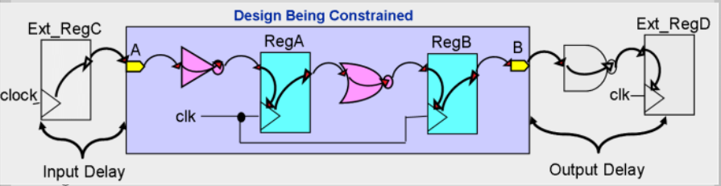

Slide 22
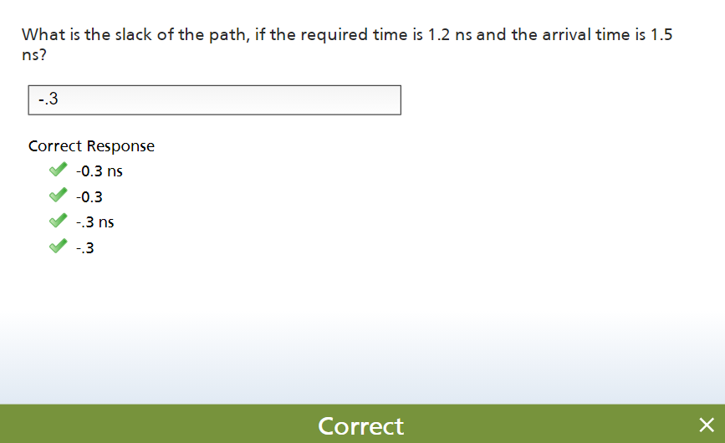

Slide 23
